Slide 1
NODE.JS INSTALLATION

Slide 2
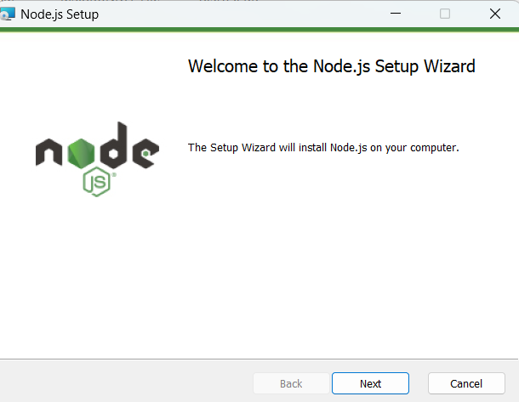
Node.js is an open source server environment.
Node.js allows you to run JavaScript on the server.

Slide 3
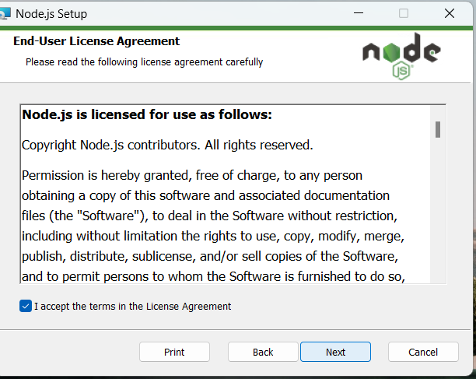

Slide 4
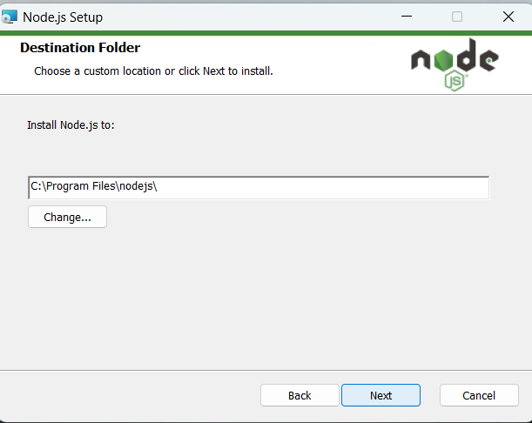

Slide 5
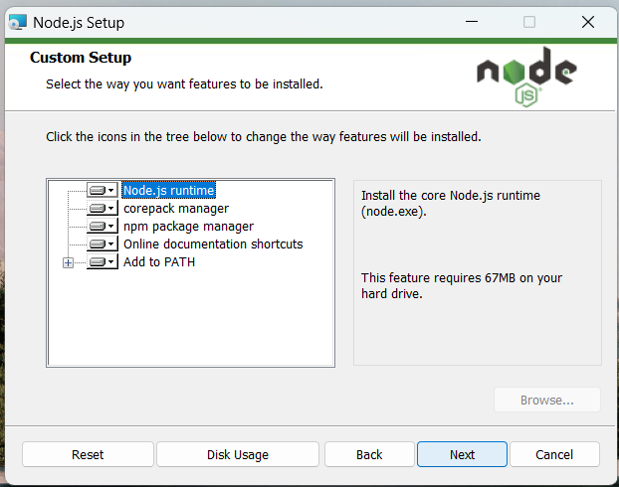

Slide 6
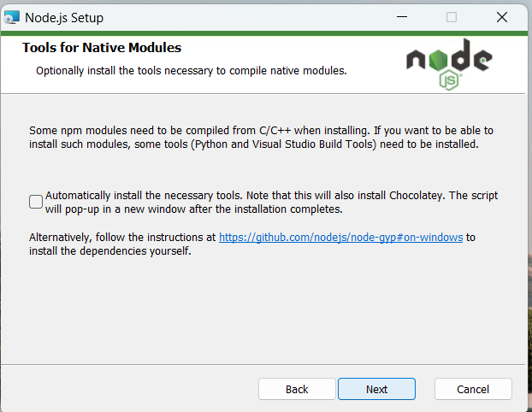

Slide 7
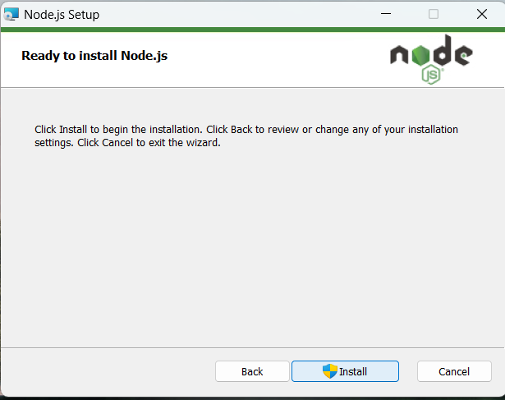

Slide 8
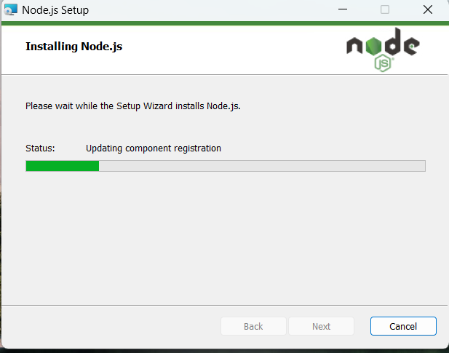

Slide 9
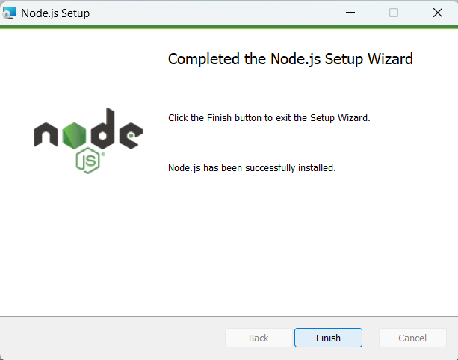

Slide 10
Angular

Slide 11
AngularJS History
AngularJS version 1.0 was released in 2012.
Misko Hevery, a Google employee, started to work with AngularJS in 2009.
The idea turned out very well, and the project is now officially supported by Google.

Slide 12
AngularJS extends HTML with new attributes.
AngularJS is perfect for Single Page Applications (SPAs).
AngularJS is easy to learn.
AngularJS is a JavaScript framework written in JavaScript.
AngularJS is distributed as a JavaScript file, and can be added to a web page with a script tag

Slide 13
Step by step process

Slide 14
step-1: check node version node –version or ng v or node -v
step-2: check npm version npm –version or npm -v
step-3: angular installation npm install - g @angular/cli
step-4: create new project ng new myNewApp
step-5: move to project directory cd mynewapp
step-6: Run server and see your application in action
ng serve -o or ng serve or ng serve -o --poll=2000
Step-7: to open code in visual studio code .

Slide 15
Code can be change in component. html * route tag should not remove in html file

